Slide 1

Sepsis Early Warning System: A Capstone Project Predicting Sepsis 6 Hours in Advance Using ICU Time-Series Data
Shirsendu Maiti| MS-BANA Capstone Project
First Reader: Prof. Sachin Modi Second Reader:

Slide 2

The Sepsis Challenge
The Problem
Sepsis is a life-threatening, overwhelming response by the body to an infection.
It's a leading cause of hospital mortality. Every hour of delayed treatment drastically increases a patient's risk of death.
The Goal: Move from detection to prediction. We need an early warning, not an "on-time" alarm.
Project Objective: Predict sepsis 6 hours in advance.

Slide 3

The Data: PhysioNet/Computing in Cardiology Challenge 2019
Source: Real-world ICU data from over 40,000 patients.
Size: 1.24+ million total patient-hours of observations.
Features: 40 vital signs & lab values (HR, Temp, Lactate, WBC, etc.).
The Challenge: Massive missing values (NaNs) and extreme class imbalance.

Slide 4
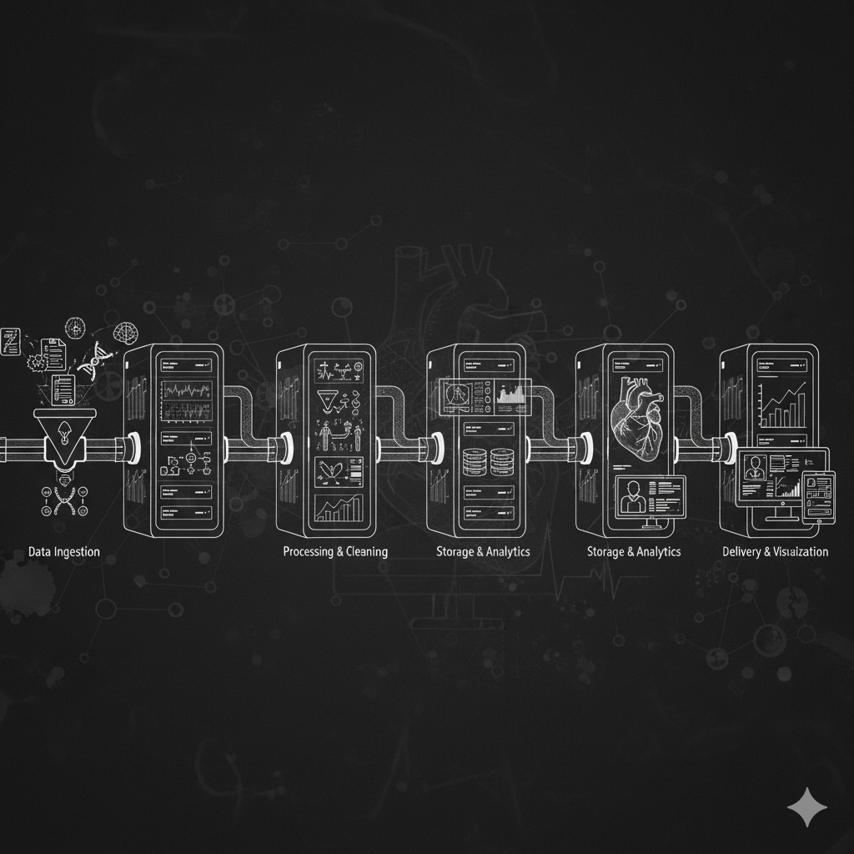
Methodology: Building the Data Pipeline
Step 1: Imputation: Filled all missing values (NaNs) using 'forward-fill' (ffill). This assumes a patient's last-known vital sign is stable until a new one is taken.
Step 2: Train/Test Split: This is a critical step.
-Method: Split by patient_id, not by row.
-Why? To prevent data leakage.
This ensures the model is tested only on patients it has never seen before, giving an honest performance score.
Part 1 - Data Pipeline

Slide 5

Methodology: The "Sliding Window"
1. The "Lookback" (Features X):
Calculated 12-hour rolling trends (mean, max, std) for all 34 vitals.
Result: 107 new features (e.g., HR_mean_12hr, Lactate_max_12hr).
2. The "Lookahead" (Target y):
Changed the question from "Is the patient septic now?"
to "Will the patient be septic in the next 6 hours?"
Part 2 - Feature Engineering

Slide 6

Model Selection & Tuning
Baseline: Logistic Regression (A simple, interpretable statistical model).
Baseline: Logistic Regression (A simple, interpretable statistical model).
Challenger: XGBoost (A powerful, industry-standard model that finds complex, non-linear patterns).
Process:
Effective body language enhances your message, making it more impactful and memorable:
Used ‘RandomizedSearchCV’ on a 250,000-row sample to find the best hyperparameters.
Re-trained the final, winning model on the entire 1.24 million-row dataset to ensure maximum performance.

Slide 7
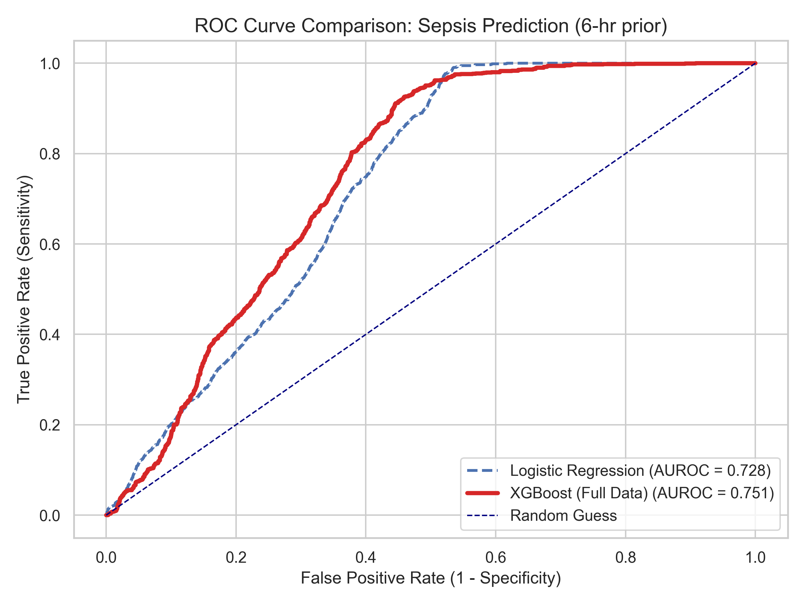
Results (Part 1 - The ROC Curve) Can the Model Separate Patients?
Key Metric (AUROC): Measures the model's ability to rank a random
septic patient higher than a random healthy patient.
Result: XGBoost AUROC = 0.751

Slide 8
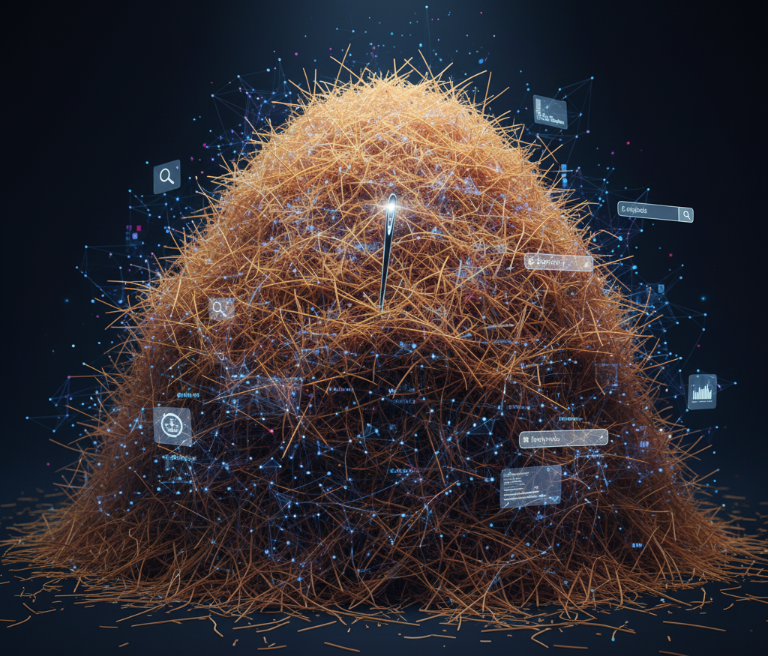
The "Needle-in-a-Haystack" Problem
Key Finding: This project's biggest challenge isn't the model, it's the data.
The Problem: Only 0.48% (less than half a percent!) of the patient-hours in my 6-hour window are "positive" for sepsis.
This means: For every 1 true sepsis case, there are over 200 healthy cases.
Why this matters: This is an extreme Class Imbalance. "Accuracy" is a useless metric.

Slide 9
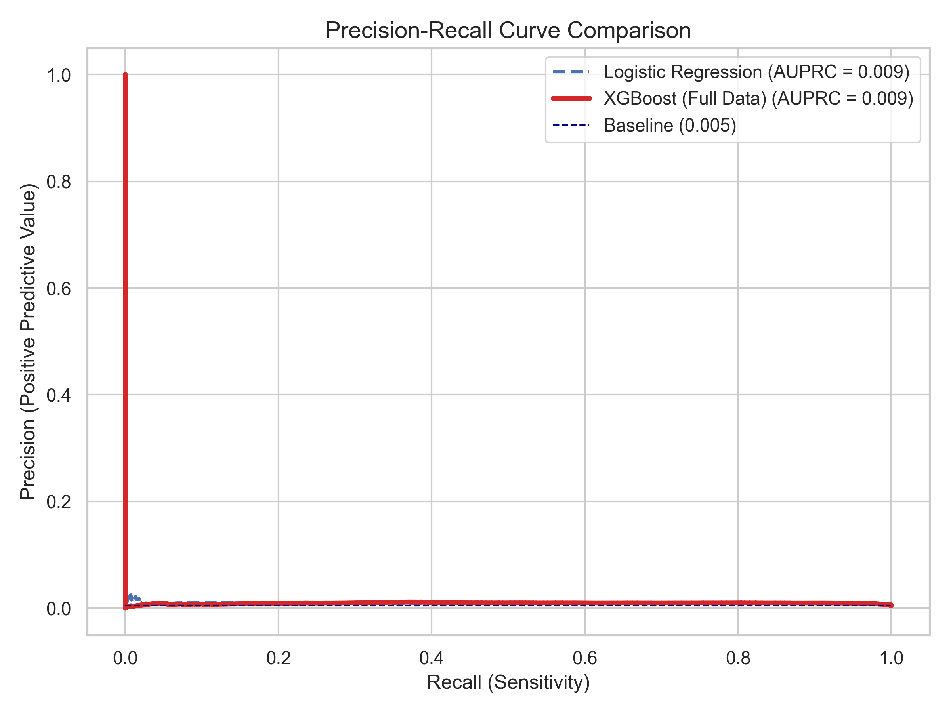
Results (Part 2 - AUPRC)
Key Metric (AUPRC): Measures Precision vs. Recall. It's the best metric for "needle-in-a-haystack" problems.
Result:
Baseline (Random Guess): 0.005
XGBoost (Full Data): 0.009

Slide 10
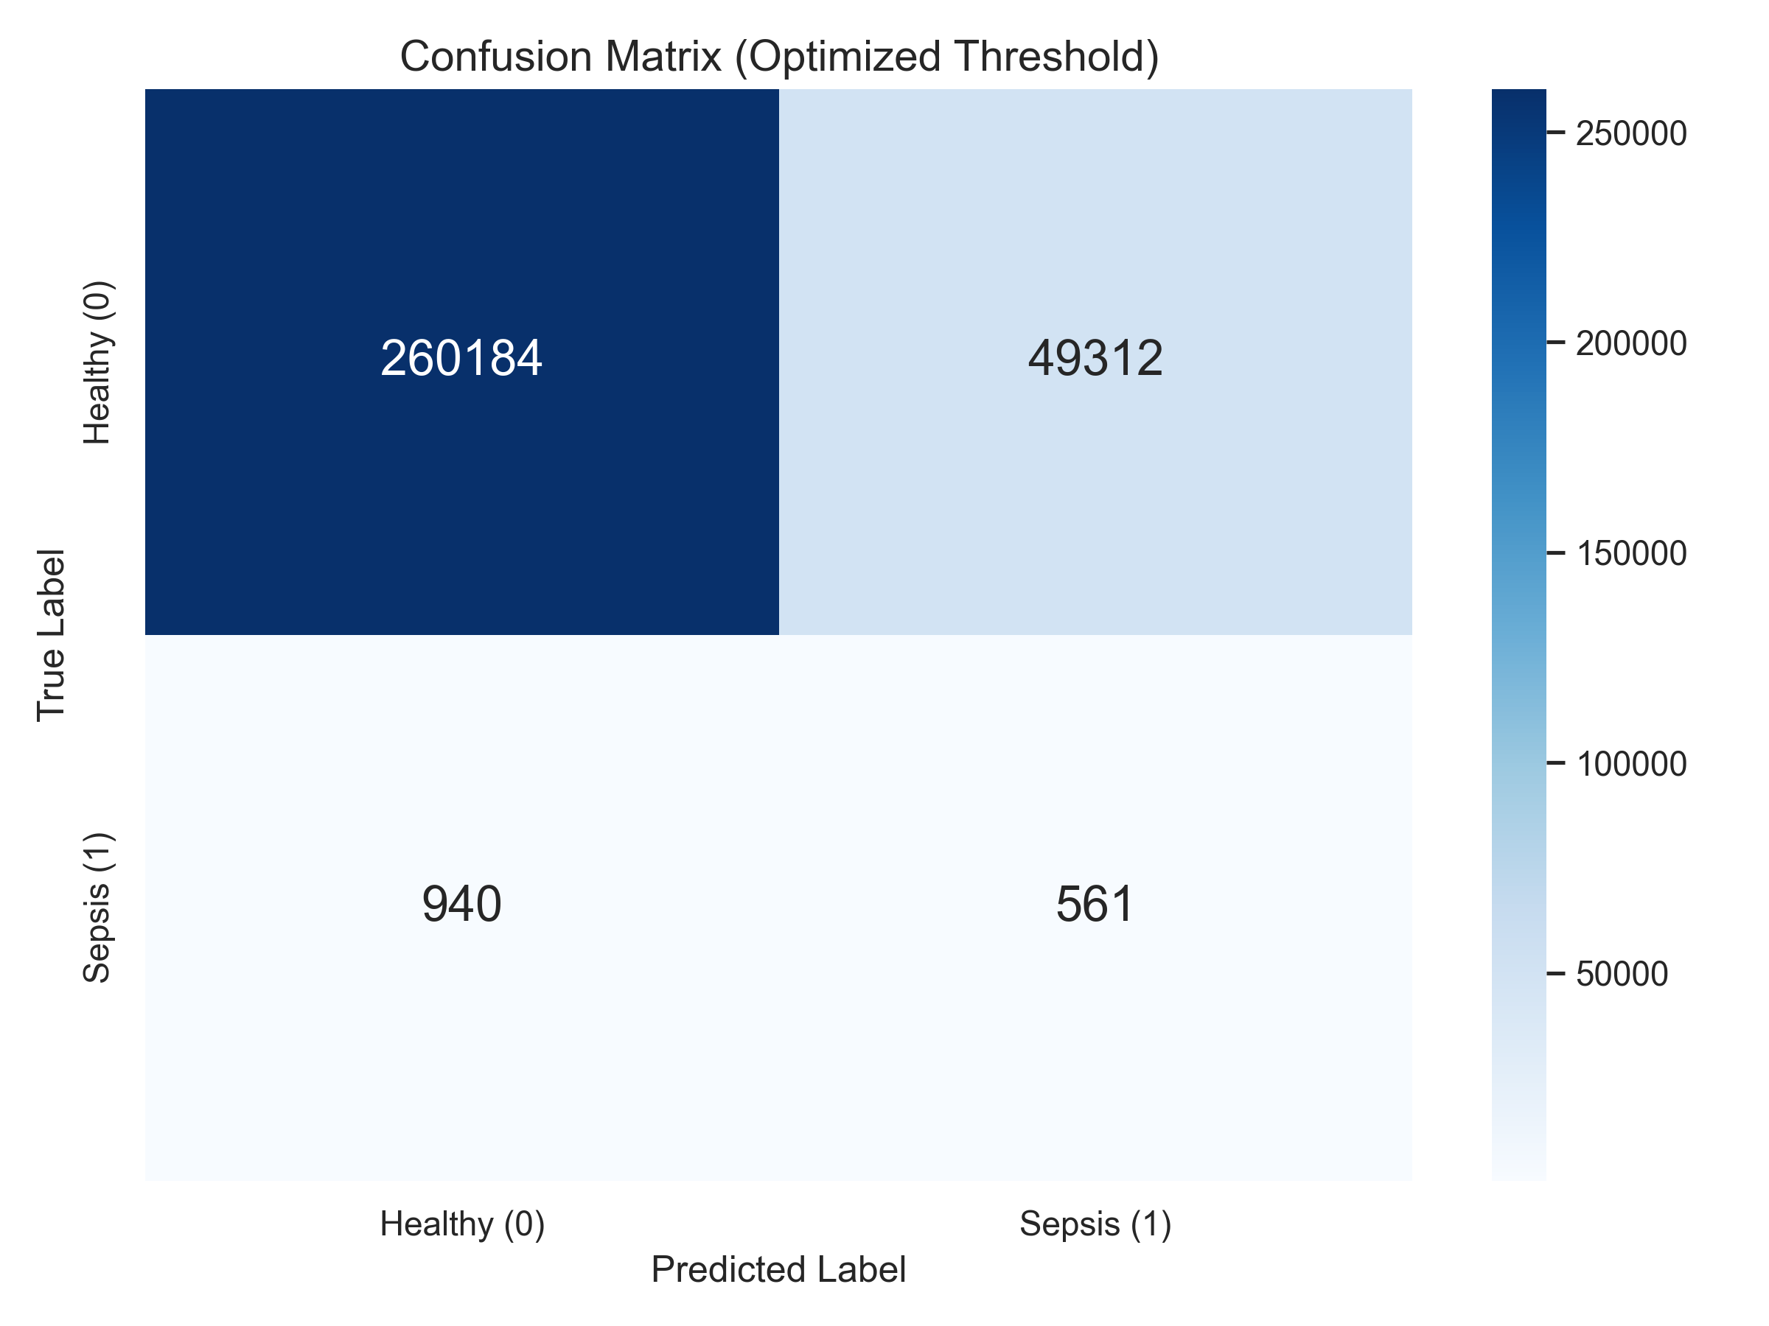
Results (Part 3 - Confusion Matrix)
Key Finding: This matrix explains the AUPRC score.
True Positives: We correctly found 561 sepsis cases 6 hours in advance.
False Negatives: We missed 940 cases.
False Positives: To find those 561 cases, the model generated 49,312 false alarms.
Finding best threshold based on F1-Score
Best Threshold found: 0.5775
This threshold gives
F1: 0.0218
At this threshold: Precision=0.0112, Recall=0.3738

Slide 11
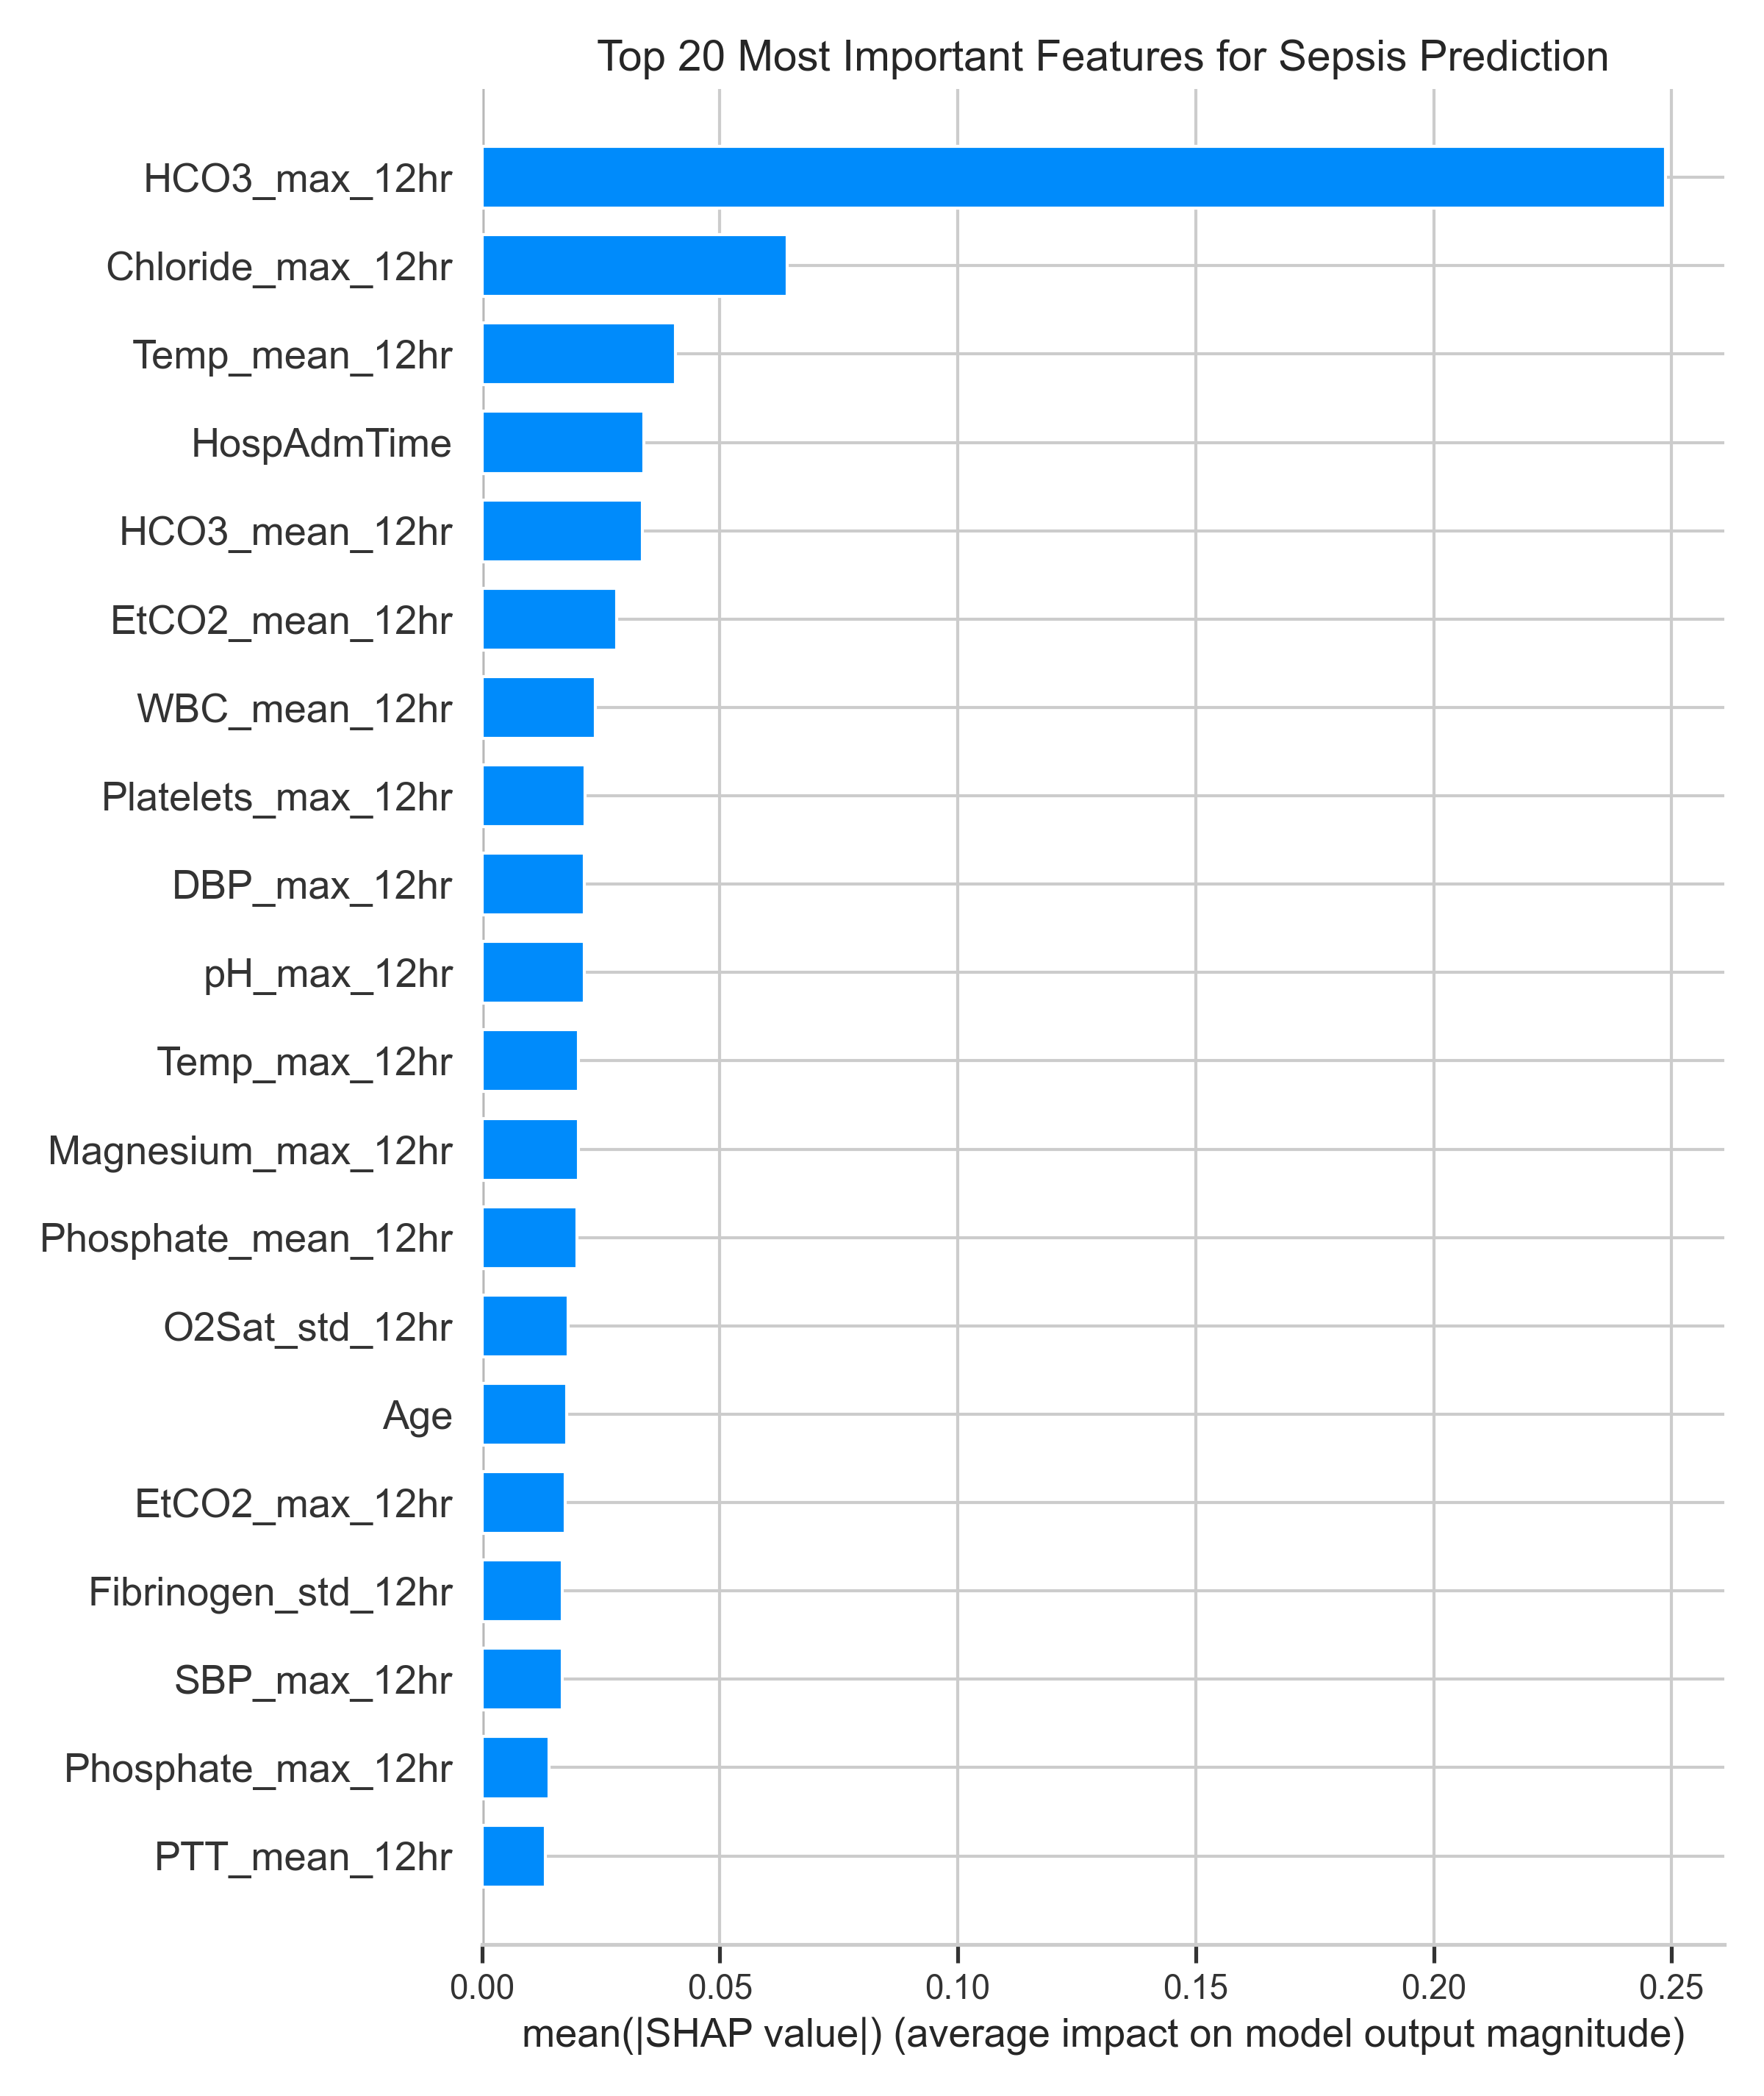
Why Does It Work? Model Interpretability (SHAP)
Finding: The model is not a "black box." It learned real clinical patterns.
Top Predictors:
HCO3_max_12hr (Bicarbonate)
Chloride_max_12hr (Chloride)
Temp_mean_12hr (Temperature)

Slide 12
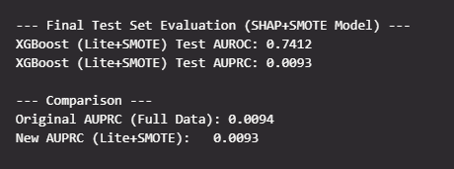
Additional Findings (The "Failed" Experiments)
Experiment 1: Under-sampling (3:1 ratio).
Result: AUPRC dropped from 0.0094 to 0.0084.
Experiment 2: SHAP Feature Selection + SMOTE (Oversampling).
Result: AUPRC dropped from 0.0094 to 0.0093.
Conclusion: More data is better. My model needs the full 1.2 million "healthy" rows to learn the subtle context. Throwing away data or adding synthetic data worsened performance.

Slide 13

Limitations & Future Improvement
1. Computational Limitations:
Tuning on 1.2M+ rows with 170 features is very memory-intensive. Parallel processing (n_jobs > 1) repeatedly caused the system to hang, forcing a "sample-then-retrain" strategy.
This limitation also made LSTMs (a more complex time-series model) unfeasible. LSTMs require reshaping the entire 1.2M+ row dataset into a 3D data cube, which is even more computationally taxing and prone to failure on the available hardware.
2. Data Limitations:
The 0.48% positive rate is the single biggest hurdle. The model would be dramatically more accurate if it could be trained on a dataset with a higher prevalence of positive sepsis cases.
3. Future Work:
Engineer "slope" features (rate of change).
With access to GPU-based cloud computing, I would implement the LSTM model.

Slide 14
Conclusion Key Project Findings
Success: Built a model with a strong AUROC of 0.751.
Discovery: Proved this is a "needle-in-a-haystack" problem (0.48% prevalence),
and the model doubled the baseline AUPRC.
Insight: SHAP analysis showed the model learned real clinical patterns,
prioritizing Bicarbonate (HCO3) as the top predictor.

Slide 15
Inspiration
The Competition: Early Prediction of Sepsis
The 2019 PhysioNet/Computing in Cardiology Challenge was titled "Early Prediction of Sepsis from Clinical Data.“
The primary goal was for teams to develop automated, open-source algorithms that could predict the onset of sepsis. The challenge used a large dataset of de-identified data from over 60,000 ICU patients.
A key aspect of the competition was its unique scoring system. It wasn't just about accuracy; it used a "clinical utility-based" metric that:
- Rewarded algorithms for correctly predicting sepsis several hours before its clinical onset.
Penalized algorithms for late predictions (after onset), missed detections, and false alarms.
The competition was ranked based on the algorithm that achieved the highest score on a hidden test set.
Winning Team:
James Morrill, Andrey Kormilitzin, Alejo Nevado-Holgado, Sumanth Swaminathan, Sam Howison, and Terry Lyons.
Their victory was based on a highly-specialized feature engineering technique. The model was called the "Signature-Based Model," which is based on a mathematical concept called rough path theory.

Slide 16

REFERENCE
Dataset : https://physionet.org/content/challenge-2019/1.0.0/
Imbalanced-learn(SMOTE) and SHAP Documentation
Concepts applied from MS-BANA courses: Statistical Modelling, Data Mining I and II, Machine Learning from Intelligent Data Analysis

